Slide 1
SC1015 Mini Project
APP PERFORMANCE PREDICTOR
Group members (DSF2 Group 7):
Lim Kang Wei (Aaron)
Oo Yifei
Ivan Lim Khai Ze
Notes:
Good day everyone. We are group 7 from lab dsf2 and this is our sc1015 mini project entitled app performance predictor.Our group members consists of Aaron, yifei and me, Ivan, and in this presentation, we will present the the key findings of the analysis of the android market and takeaways of this project.

Slide 2
TABLE OF CONTENTS
01
02
03
04
05
06
Problem Formulation
Introduction
Data Preparation
Exploratory Data Analysis
Model Building & Machine Learning
Conclusion
Notes:
This is the flow of our presentation, we will begin by introducing our motivation, followed by how we came up with the problem formulation. Followed by data preparation, eda, and machine learning. Finally, we conclude our key findings and what we learnt in this project.

Slide 3
INTRODUCTION
190 B Downloads in 2018
Projected to reach 230 B in 2023
- Statista
Notes:
In today’s world, apps have been playing an important role in every one’s daily life. This apps can be Exommerce apps, social media apps and entertainment mobile apps. Therefore it is nearly impossible for us to stay away from any apps in our life.
According to statista, the total installations for mobile apps has reached 190 billion downloads in 2018, and it is projected to grow to 230 billion by the end of 2023. However, not all apps are as successful as the ones in the global leaderboard due to various reasons. Due to this, we are motivated to explore the reasons behind why some apps can be successful while others failed.

Slide 4
Problem Formulation
How different features of an app affect its popularity?
Notes:
This leads to our problem formulation, which is how different features of an app affect its popularity.We have considered to analyse the market on google play store to solve this problem as it has the largest market in the mobile apps industry

Slide 5
Data Preparation
01
02
Web Scraping
Data Cleaning
Notes:
With that being said, we moved on to prepare our data by web scraping on the google play store.

Slide 6

Web Scraping
54
3
23952
CATEGORIES
COLLECTIONS
Action games, lifestyle, sports etc.
Top free, top paid, top grossing
APPS SCRAPED
Notes:
In this step, we wrote a program to execute the google play store api in javascript to scrape the google play store. We achieve our target by scraping across 54 categories such as action games, lifestyle apps, sports ec cetera. We also targeted the big 3 collections in the android market, which are the top free apps, top paid, and top grossing. In the end, we are able to scrape for around 24 thousand apps.

Slide 7
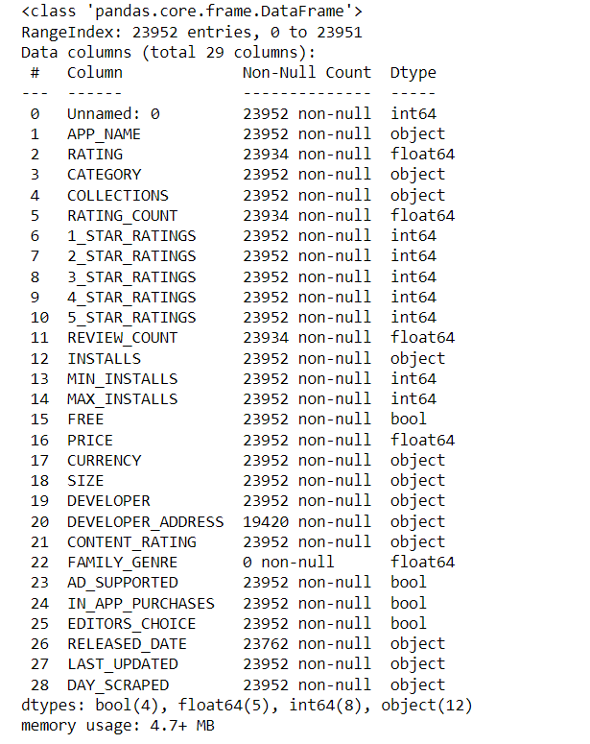
Web Scraping
Notes:
This is the output of our web scraping. We are left with 29 columns and around 24000 apps.

Slide 8
Data Cleaning
Steps
Remove irrelevant columns
Reformat dates to dd/mm/yy
Dealing with null values
Drop rows
Impute with median
Set to unique category
Drop duplicate apps
Dealing with addresses
Notes:
So in data cleaning, we did mainly 5 steps to ensure our data is ready for exploration. First, we removed irrelevant columns. We then reformatted our dates to a format of date/month/year. Next, we dealed with null values from the scraped data using 3 methods which are either dropping them, impute them with median or set them to a unique category. And then, we dropped duplicate apps. Which brings us to our final step which is to deal with addresses which I ll elaborate more on this step.,

Slide 9
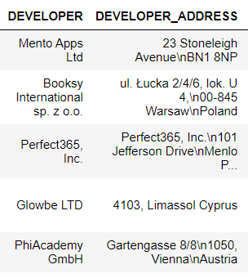
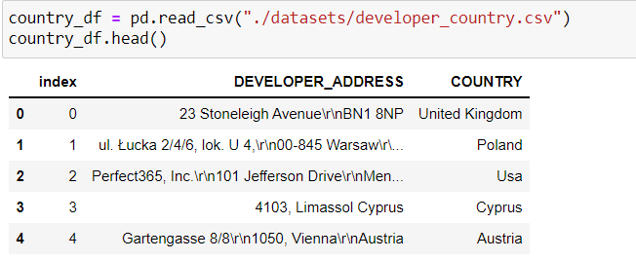

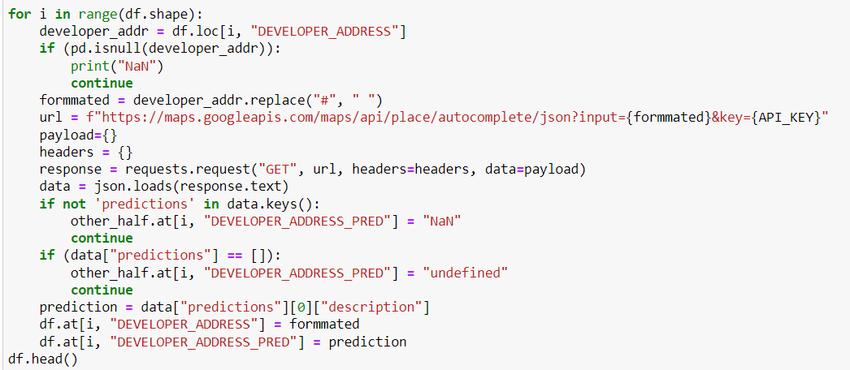
Dealing with address
Notes:
In our raw data, we noticed that the developer address is the actual address of the developer which is not useful in its current form. So we decided to only extract the country of the developer’s address for eda purposes. (next) This brings us to write a program using the google maps api, to predict the country of the given address. (next) So this is the results of the program and we just replace every developer address with its country in the eda. The other cleaning steps are further elaborated in the jupyter notebook.

Slide 10
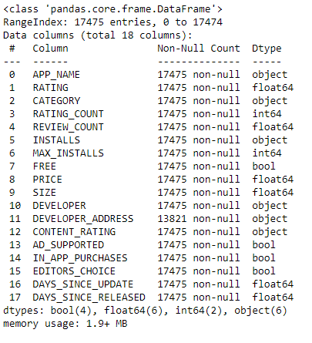
Data Cleaning
Before
23952 rows
29 columns
After
17475 rows
18 columns
Notes:
In the end, we are left with around 17 thousand apps and 18 columns to explore with. Next, I’ll pass my time to Aaron for eda.

Slide 11
Feature engineering
From | To
SIZE | SIZEBAND
PRICE | PRICEBAND
DAYS_SINCE_RELEASED | DAYS_SINCE_RELEASED_RANGE
DAYS_SINCE_UPDATE | DAYS_SINCE_UDPATE_RANGE
INSTALLS | INSTALLS_GROUP
New features | REVIEW_RATE, RATING_RATE, COUNTRY
Notes:
Before we start with the EDA, we will do some feature engineering.
We have changed some numerical variables to categorical.

Slide 12
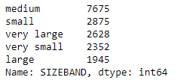
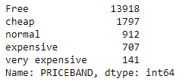

SIZEBAND
PRICEBAND
INSTALLS_GROUP
Notes:
For example, we changed the SIZE feature to SIZEBAND and PRICE feature to PRICEBAND.

Slide 13

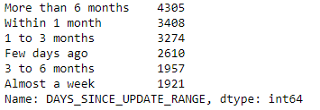
DAYS_SINCE_RELEASED_RANGE
DAYS_SINCE_UPDATE_RANGE
Notes:
The reason we did this is to improve the signal-to-noise ratio. Fitting a model into bins reduces the impact that small fluctuates in the data have on the model. Each bin minimises the noises in sections of the data.
Also, we simplified the developer's address into a COUNTRY column for the geospatial analysis later on. This is done using Google's API.

Slide 14
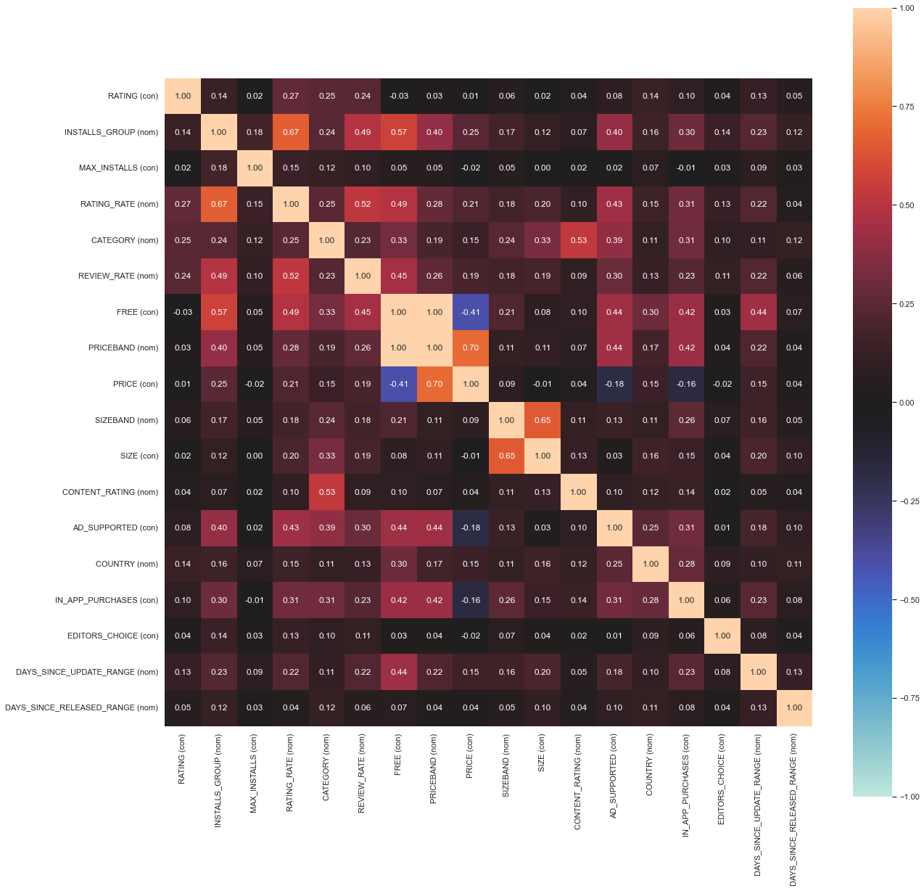
TARGET VARIABLE FOR EDA
Notes:
So if we take a look at all variables we have in hand, we can consider using rating or installs as an indicator of the performance of an app. But, if we look closely:
Installs have a higher association value with other variables compared to ratings.
And the categorical variables have higher association values compared to its numerical form.

Slide 15
Installs group EDA
Notes:
Hence, our primary EDA will focus on the behaviour of installs_group.

Slide 16
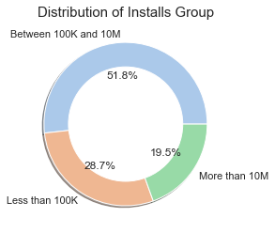
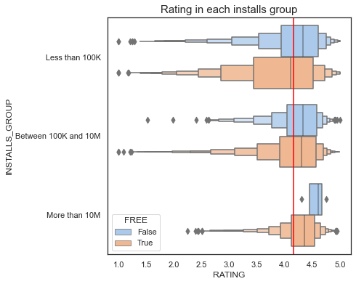
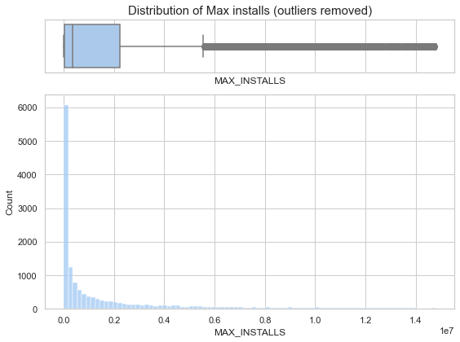
Distribution of Installs
Notes:
Almost half the number of apps have been installed, between one hundred thousand and 10 million.
The distribution of installs is highly skewed positively.
Paid apps with more than 10M installs are most likely to be rated higher, and it's less spread out on the rating axis.
The red vertical line in the right figure is the average rating of apps on Google Playstore, which is 4.16.

Slide 17
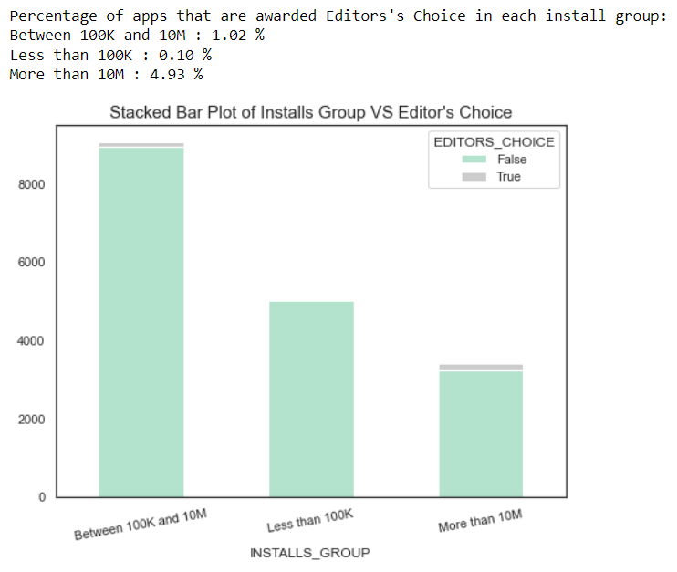
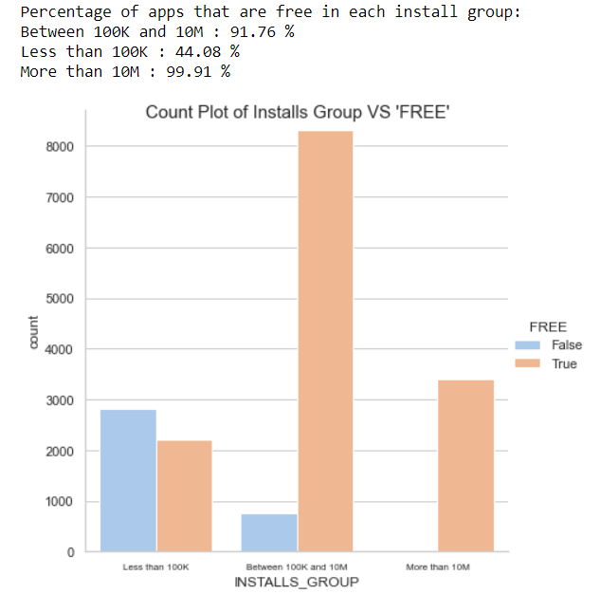
INSTALLS_GROUP EDA
Notes:
Next, we noticed that most of the apps are not awarded with 'Editor's Choice'. But there's a slight increase in the likeliness of an app being an 'Editor's Choice' app if they have more installs.
Apps with more than 100K installs are more likely to be free. And if an app is paid, it's more likely to have less than 100K installs.

Slide 18
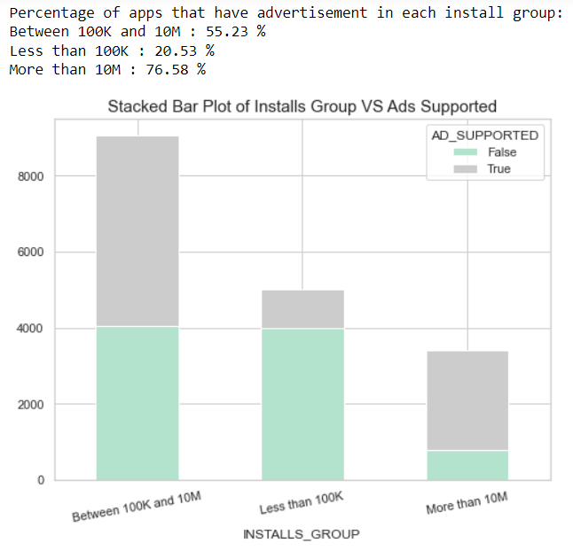
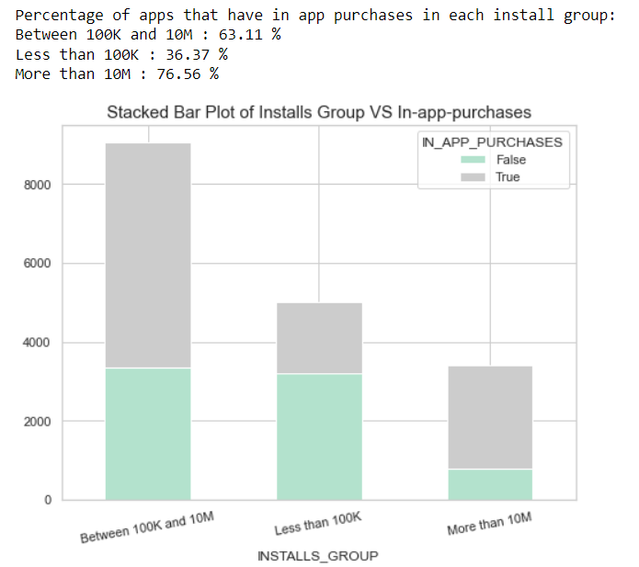
INSTALLS_GROUP EDA
Notes:
Apps with more than 100K installs are more likely to be ad-supported and have in-app purchases as the developer company might need a source of income to maintain the company and the app.

Slide 19
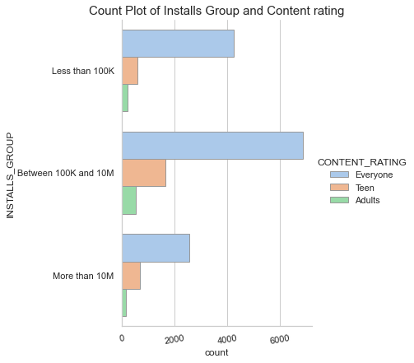
Installs group VS content rating
Notes:
Most of the apps in this dataset are for everyone. And 'Adults' apps are significantly low in all install groups, especially for apps with more than 10M installs.

Slide 20
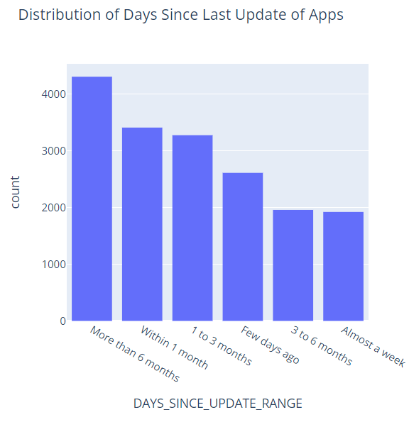
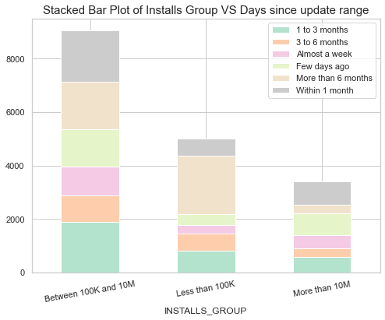
Installs group VS Days since update
Notes:
Most of the apps are updated more than six months ago or within one month. Especially for apps with more than 10M installs, they were updated a few days ago or within one month ago.

Slide 21
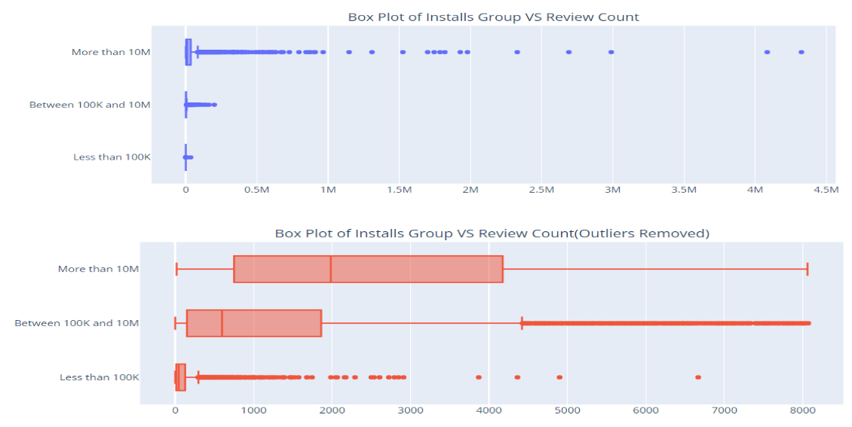
Installs group VS Review count
Notes:
There's a significant increase in installs as the apps get more reviews. Apps with more than 10M installs have an extreme review count. But the distribution is quite even compared to the other 2 groups because the majority of the apps with 10M installs are dispersed in 1000 to 4000 reviews. This is considered a wide gap compared to apps with less than 100K installs.

Slide 22
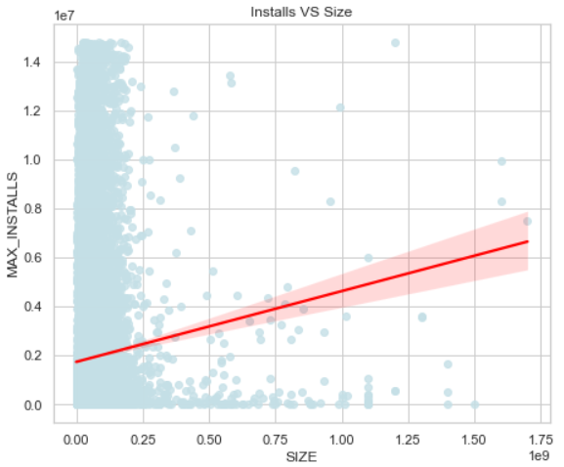
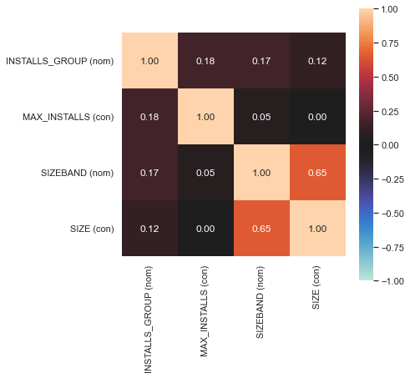
Installs VS Size
Notes:
There's a strong linear relationship between max installs and size, but their correlation is very low. But if we were to change our perspective to comparing installs group and size band, the association value looks more reasonable.

Slide 23
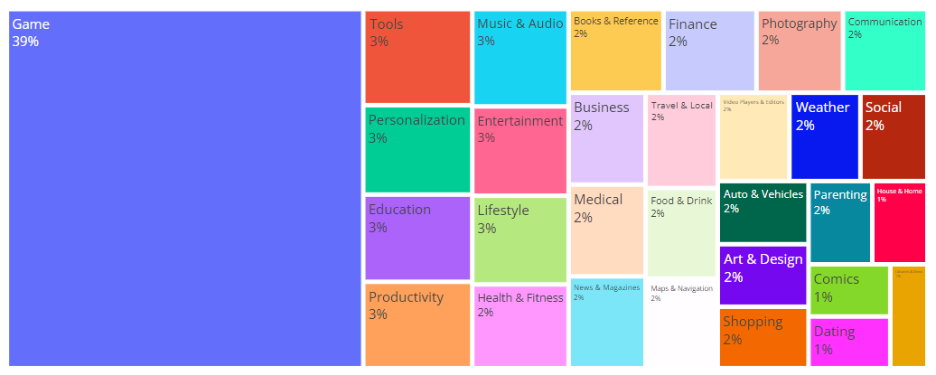
Distribution of categories (based on app count)
Notes:
Based on app count, games are the most developed sector. 39% of the apps in the market are games, followed by tools, music and audio, entertainment, education, productivity, etc.

Slide 24
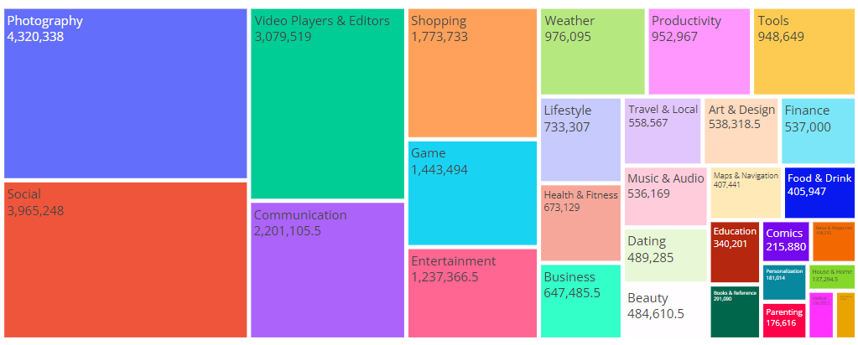
Demographic of top median installs per category
Notes:
But, if we switch our angle to median installs, photography takes the lead, with social being placed at the second high. We decided to use median instead of mean because it does a better job of capturing the central distribution location when there are extreme outliers present in the data.

Slide 25
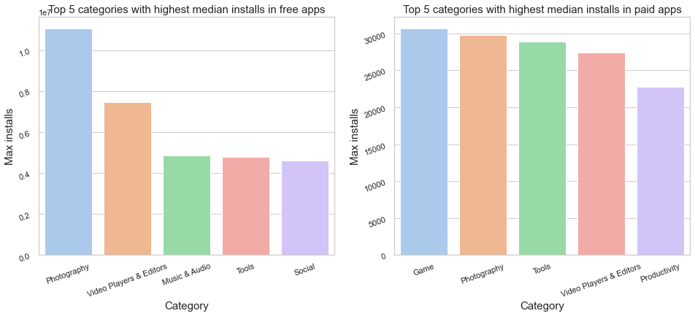
Top 5 categories for Free/Paid apps
Notes:
Then, if we further dissect this analysis into whether it's free or paid. The result changes. Photography is still the most installed in free apps. But, game apps came back to the top in the paid app sector.

Slide 26
EDA takeaways
Please refer to our EDA notebook regarding Singapore apps, FANG apps and geospatial analysis :D
More than half of the apps have 100K-100M installs.
The average rating of an app is 4.16
Apps with more than 10M installs have a higher chance to be chosen as Editor's Choice.
99.1% of apps with more than 10M installs are free.
76.58% of apps with more than 10M installs are ad-supported.
76.56% of apps with more than 10M installs has in-app purchases.
Apps with more than 10M installs are less likely to be rated as an 'Adults' app.
Apps with more than 10M installs are frequently updated, at most within a month.
Apps with more than 10M installs has extreme review counts (more than 50 a day).
Size has a strong linear relationship with install count.
Most of the apps are games.
The best free category based on median install is photography.
The best paid category based on median install is game.
Notes:
These are the key takeaways from our EDA on installs. We have come to the end of our EDA, but we did extra EDA on Singapore apps, FANG companies, and some geospatial analysis. But they are not related to our problem statement. So, we won't present them in this video. Please refer to our EDA notebook.
I will pass the time with Yifei on model building and machine learning.

Slide 27
Original Problem Statement
How different features of an app affect its popularity?
Specific Problem Statement
Would an app exceed one million installs in a year after its release?
Notes:
Before we move to another part, let's make a recap of our problem statement, which is “How different features of an app affect its popularity?” After our EDA, we decided that we would use installs as an indicator of the popularity of an app. So, we narrowed down the question, and changed it to “Would an app exceed one million installs in a year after its release?”

Slide 28
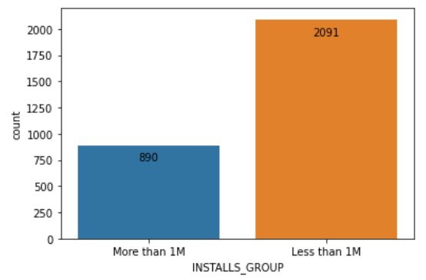
Model Building
Only new apps that are released less than one year.
Total : 2981
Less than one million installs : 2091
More than one million installs : 890
Oversampling
Random Oversampling
Synthetic Minority Oversampling Technique (SMOTE)
Notes:
So, in model building, our first step is to extract those apps which are released no longer than a year. It turns out that there are 2981 apps that meet this criteria, with 2091 of them having below 1 million installs while the 890 have over 1 million installs
Since the data here is a little imbalanced, we decided that we would do some oversampling. We approach this in two ways, the first one is random oversampling, and the other one Synthetic Minority Oversampling Technique, commonly known as smote.

Slide 29
Model Building
3. Converted all the predictors into categorical variables by using OneHotEncoder
and LabelEncoder.
LabelEncoder
OneHotEncoder (OHE)
“CATEGORY”
PRICEBAND
Free | Cheap |  | Normal | Expensive | Very Expensive
0 | 1 |  | 2 | 3 | 4
Notes:
Also, we like to mention that we converted all of the predictors into categorical variables by using one hot encoding and label encoding. we used label encoder to encode ordinal categorical variables. For example in PRICEBAND, we map free to 0, cheap to 1, and so on. On the other hand, we used one hot encoder for nominal categorical variables such as “CATEGORY” of the app, which is game, or non-game app.

Slide 30
Machine
Learning
 | Predictors
1 | REVIEW_RATE
2 | RATING_RATE
3 | FREE
4 | PRICEBAND
5 | AD_SUPPORTED
6 | DAYS_SINCE_UPDATE_RANGE
7 | CATEGORY
8 | IN_APP_PURCHASES
9 | CONTENT_RATING
10 | SIZEBAND
Notes:
Now, all the data is ready, so we can move to machine learning. Here is the list of 10 predictors that we chose. Because our problem is a classification problem, we decided to use the decision tree model.

Slide 31
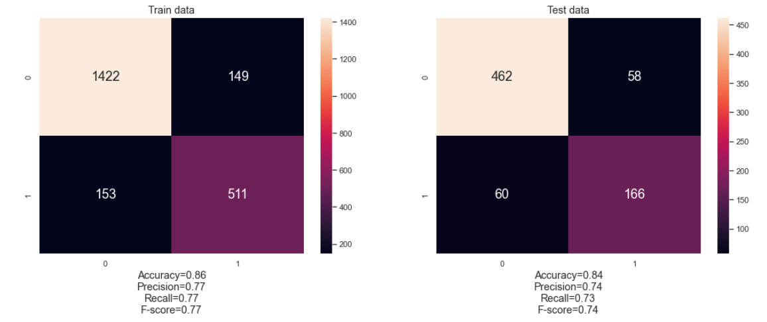
Decision Tree
Notes:
Here is our first attempt at using the decision tree model with the original data, which means there are no oversampling.
We got 86% accuracy and 77% precision in the train data, in the test set, we got 84% accuracy and 74% precision. The results are decent, but we also tried using random forest. In total, we made 7 attempts to compare which model is better.

Slide 32
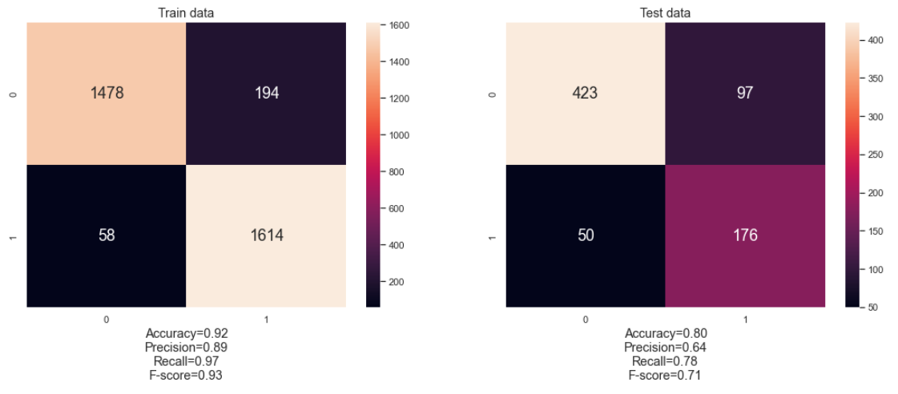
Random Forest
With GridSearchCV and SMOTE
Notes:
And here is why we think so.
Here is a summarise of the performance we got from the test data.
The oversampled data has accuracy around .80 to 0.81, which is lower compared to the data without any oversampling, that is 0.82 to 0.84. We think the oversampling has caused an increased weight in some training samples which leads to increase bias, causing overfitting to occur.

Slide 33
Test Data Performance
 |  |  | Decision Tree | Random Forest (With GridSearchCV)
Oversampling | Accuracy | random | 0.81 | 0.80
 |  | smoten | 0.81 | 0.81
Without Oversampling | Accuracy |  | 0.84 | 0.82
Notes:
And here is why we think so.
we summarise the performance we got from the test data.
If we compare the oversampled data to the original data, the oversampled data set has a lower accuracy on average, which is around .80 to 0.81 compared to the data without any oversampling, which is 0.82 to 0.84. We think the oversampling has caused an increased weight in some training samples which leads to increase bias. Eventually, causing overfitting to occur.

Slide 34
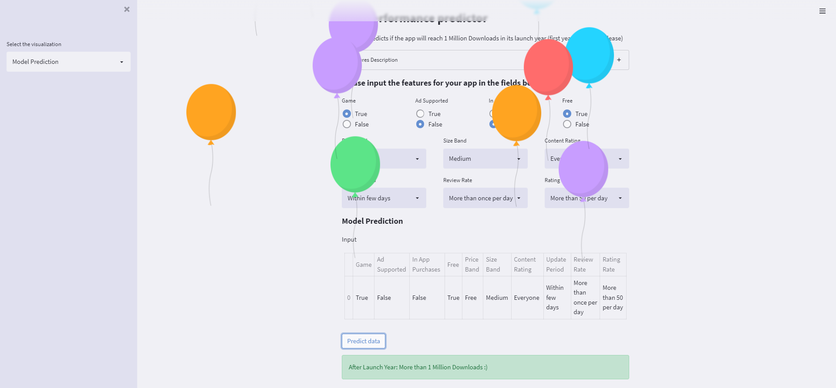
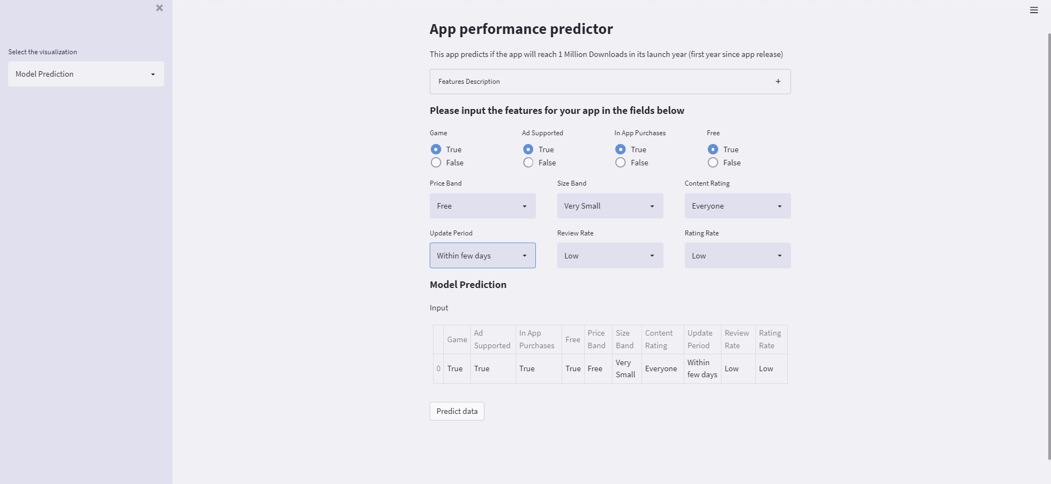
Deployment of Model
Notes:
After the model is ready, we deployed it into a web app, as you can see here, you may key in the values of these variables. Then based on the value, it would determine if the app would exceed 1 million within a year

Slide 35
What have we learned?
1
2
3
4
Web scraping using API
Oversampling Techniques
GridSearchCV
Streamlit web app
Notes:
To sum up, what have we learned from this mini project is that we learned to do web scraping using API. We scrap apps ranging from different categories across google play store. Next, we learned two oversampling techniques, which are random oversampling and SMOTE. Moreover, we also learned GridSearchCV to optimise the results of the machine learning models. Lastly, to deploy our model, we also learned to use the streamlit web app framework.

Slide 36
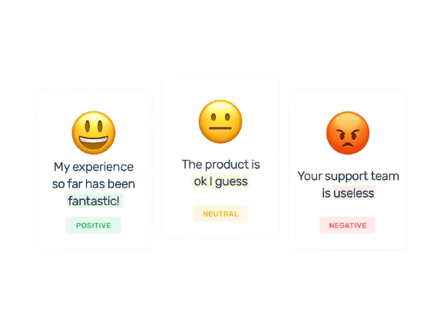
What can be improved upon?
Sentimental Analysis
Notes:
The performance of an app doesn’t just depend entirely on the features we scrap. So. an improvement is to use sentimental analysis to determine if the app has good reviews or not which could potentially help to improve our model.

Slide 37
Outcome
Predict if an app would have a higher chance in exceeding one million installs in a year.
The features that affect the number of installs of an app.
- free
- review rates
- rating rates
Notes:
Here are the outcomes of our project. Other than having a web app that could predict if an app has a high chance in exceeding 1 million installs in a year.
We also got to know the features that affect the installs of an app. We come out with a few possible strategies to increase the number of installs. One way is to make the app free. Also, it would be helpful to increase the review and rating rate of the app.
That’s the end of our presentation. Thank you!

Slide 38
THANKS!
Please keep this slide for attribution

Slide 39
Reference for slides
Published by L. Ceci, & 31, J. (2022, January 31). Annual number of mobile app downloads worldwide 2021. Statista. Retrieved April 22, 2022, from https://www.statista.com/statistics/271644/worldwide-free-and-paid-mobile-app-store-downloads/
Zychlinski, S. (n.d.). Dython. dython. Retrieved April 22, 2022, from http://shakedzy.xyz/dython/

